Slide 1


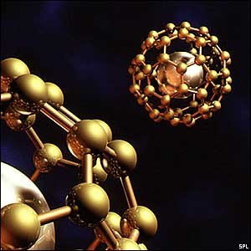
THIRD YEAR T.D.C., SCIENCE
PHYSICS
PAPER-III, Part G
Paper Code - 3163
SOLID STATE, NUCLEAR
AND PARTICLE PHYSICS

Slide 2

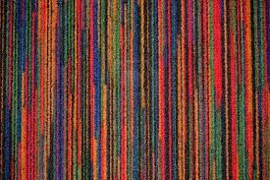
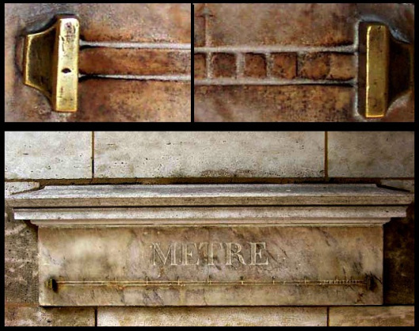
LENGTH SCALES
Meter (m)
Millimeter (mm) = 10⁻³ m
Micrometer (μm) = 10⁻⁶ m
Nanometer (nm) = 10⁻⁹ m
Picometer (pm) = 10⁻¹² m
Femtometer (fm) = 10⁻¹⁵ m
Gulliver in Lilliput
Jonathan Swift

Slide 3
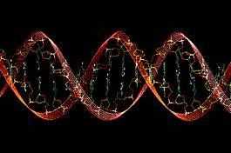
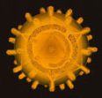
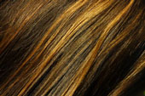
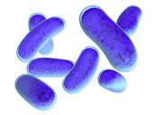
Length Scales : comparison of sizes
Electron, Proton, Neutron, Nucleus
≈ 1fm (10⁻¹⁵m)
Human DNA
molecule ≈ 2.5nm
10 hydrogen atoms ≈ 1 nm
Atom ≈ 0.1nm (1Å)
Virus ≈ 20nm
Human hair
≈ 10 microns
Bacteria ≈ 1 micron (1000nm)

Slide 4
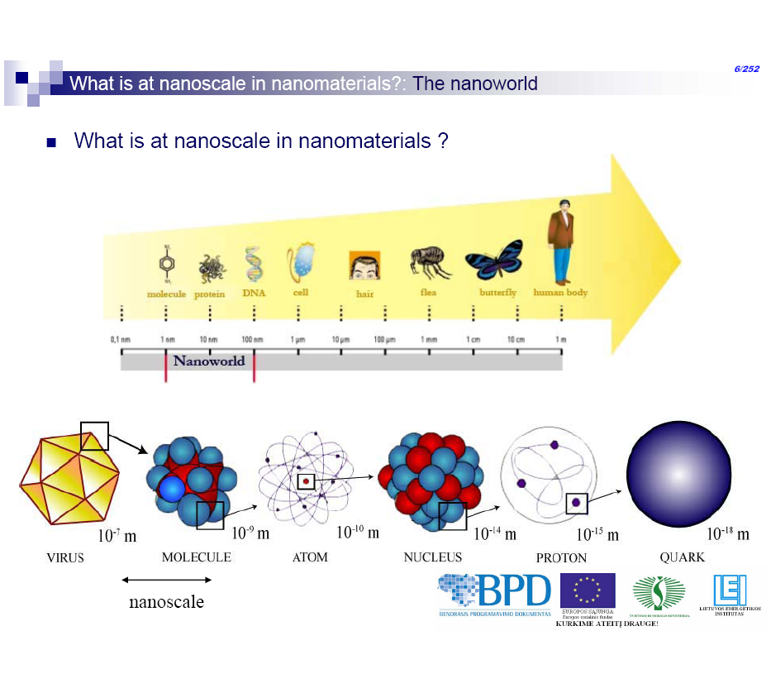
Length Scales : comparison of sizes

Slide 5
What is Nanotechnology?
It is the design, fabrication, characterization & utilization of materials/devices which are of the order of 100 nm in atleast one dimension
Two Nominal Approaches:
Top down: Starting from a big structure and chipping away eg. Milling, etching, rolling, dispersion
Bottom up: building atom-by-atom or molecule-by-molecule

Slide 6
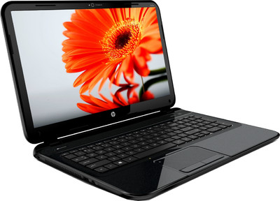
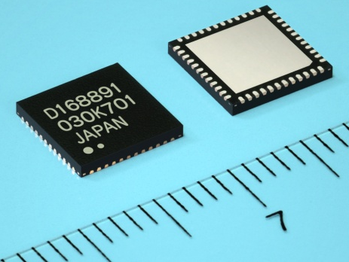
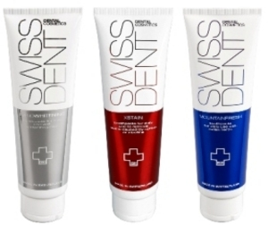
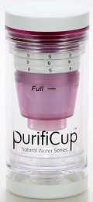
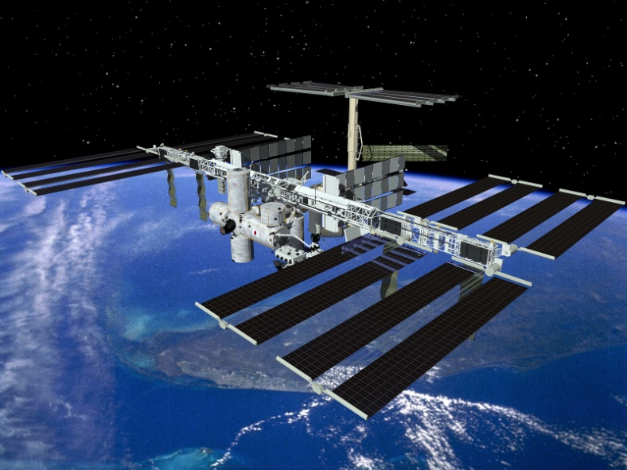
Why do we require smaller devices?
Faster
Cheaper !!!
Can get into smaller spaces
Lighter and so more energy efficient

Slide 7
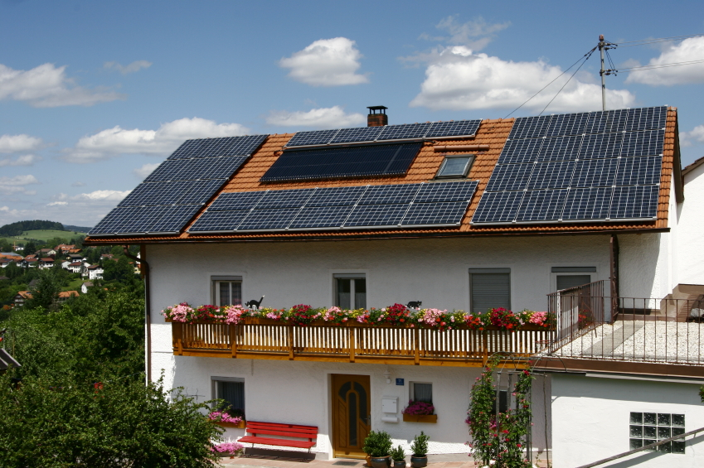
Why is the nano size so exciting?
This size represents an ideal one to manipulate matter
A basic unit cell, lets say NaCl, has a size of about 6Å or 0.6nm (accurately - 5.639Å) ⇒ a 6nm sized cluster or grain would have about 10 NaCl units
Anything less would destroy the structural integrity since there wouldn’t be enough units to interact or behave to display properties unique to it.
Properties of the same material when nanosized are very different from the bulk; often enhanced
Tailoring of materials with specific properties are now possible
For eg. a min. no. of bricks are necessary to make a recognizable structure like a house

Slide 8
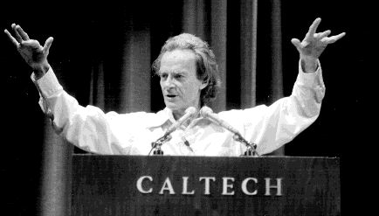
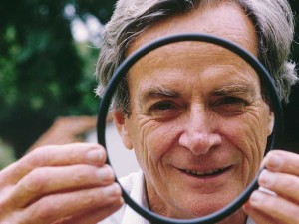
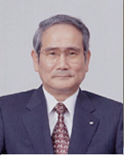
CONTRIBUTERS
THERE’S PLENTY OF ROOM AT THE BOTTOM
This is the title of a lecture given by Nobel prize winning Physicist Richard Feynman at a meeting of the American Physical Society at Caltech on 29th December, 1959. In this talk he explored the possibility of manipulating matter at the atomic level to give rise to new, powerful technique and is what is now called ‘Nanotechnology,
Norio Taniguchi was a professor of Tokyo University of Science. He coined the term Nano Technology in 1974 to describe semiconductor processes such as thin film deposition and ion beam milling exhibiting characteristic control on the order of a nanometer: "Nano-technology' mainly consists of the processing of separation, consolidation, and deformation of materials by one atom or one molecule."

Slide 9
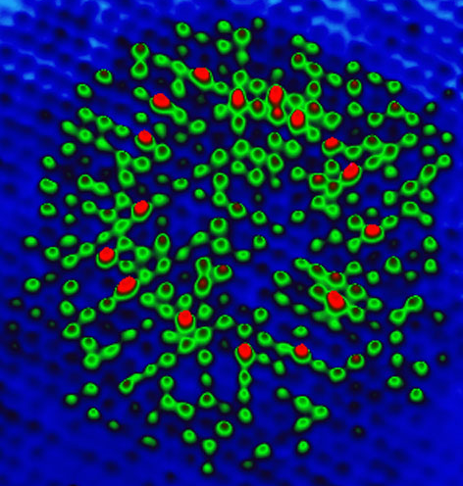
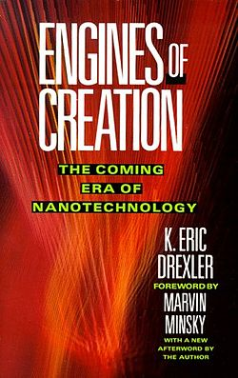
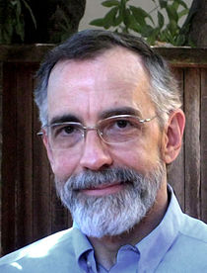
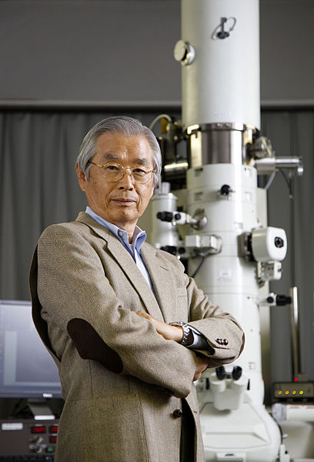
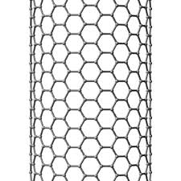
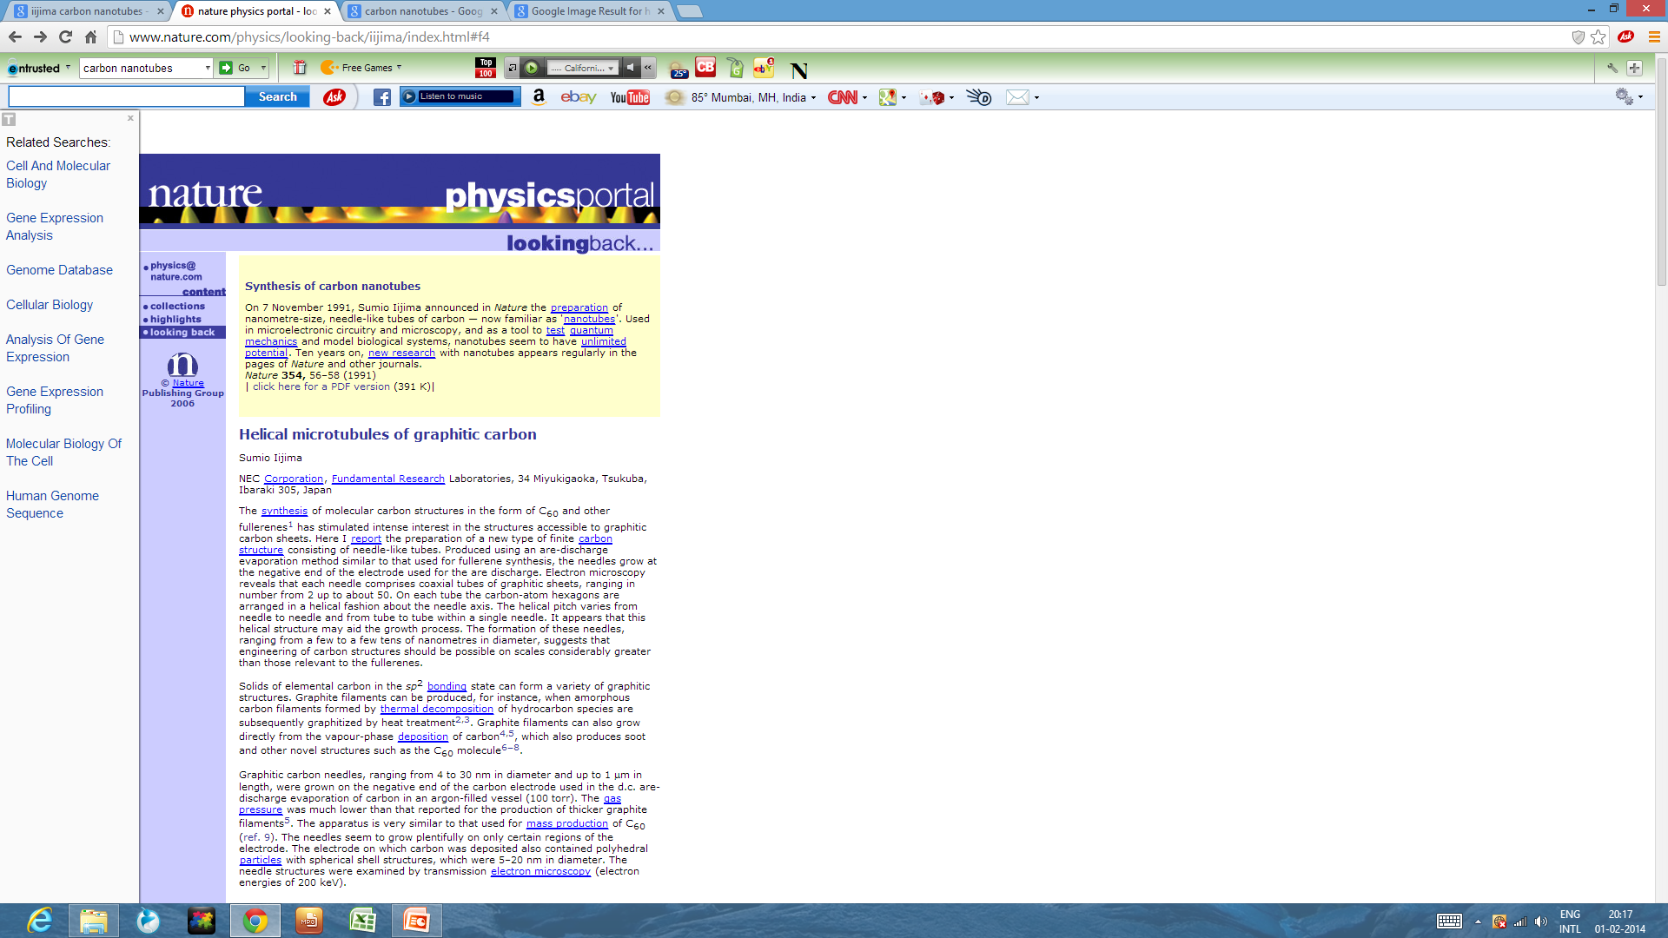
CONTRIBUTERS
K. Eric Drexler is known for popularizing the potential of molecular nanotechnology (MNT).
1986
Sumio Iijima is a Japanese physicist, often cited as the inventor of carbon nanotubes. Although carbon nanotubes had been observed prior to his "invention", Iijima's 1991 paper generated unprecedented interest in the carbon nanostructures and has since fueled intense research in the area of nanotechnology.

Slide 10
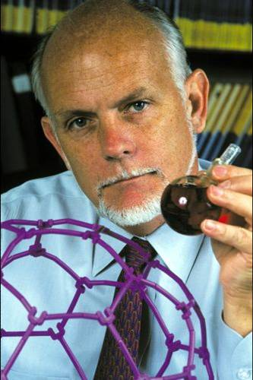
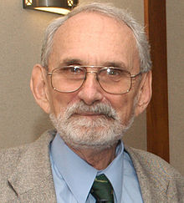
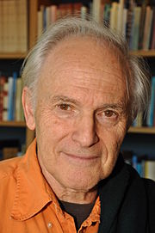
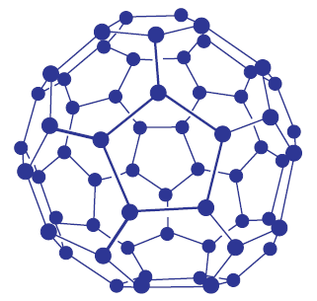
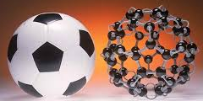
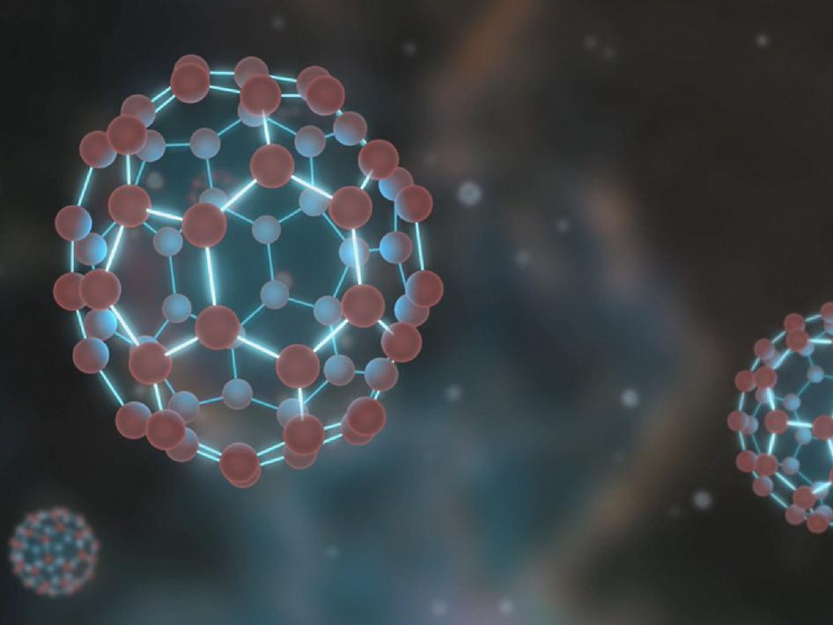
CONTRIBUTERS
Smalley
Curl
Kroto
In 1985, while investigating the constituents of astronomic dark matter, Richard Smalley, Robert Floyd Curl, Jr., Sir Harold (Harry) Walter Kroto, and their students discovered the third allotrope of carbon - C₆₀ – the buckminster fullerene molecules or bucky ball.

Slide 11
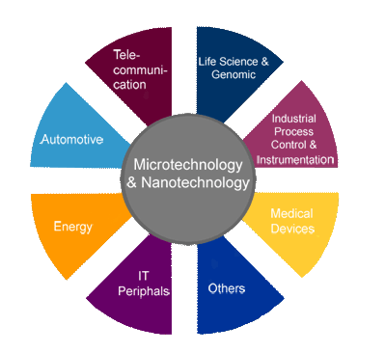
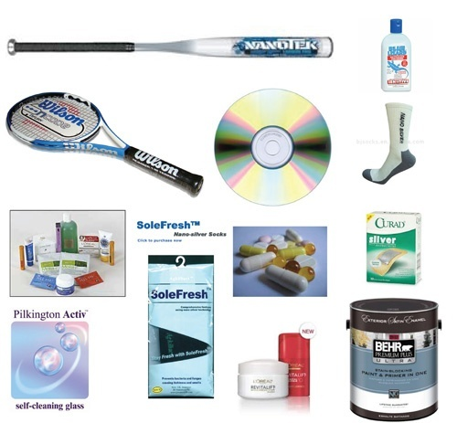
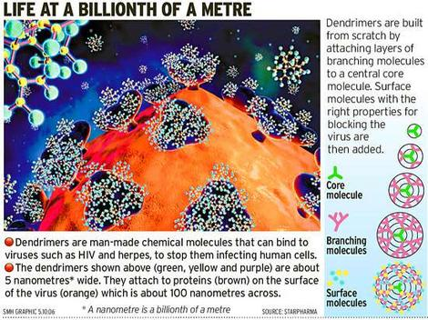
The new technological revolution in the 21st century is nanotechnology
Since it forms the backbone of most other highly evolved emerging innovations in global technologies
Examples : innovations based on electronics, communication/information, environmental and health related technologies.

Slide 12
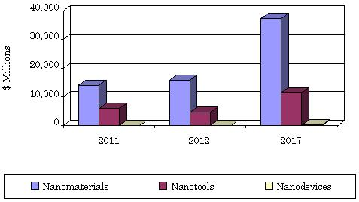
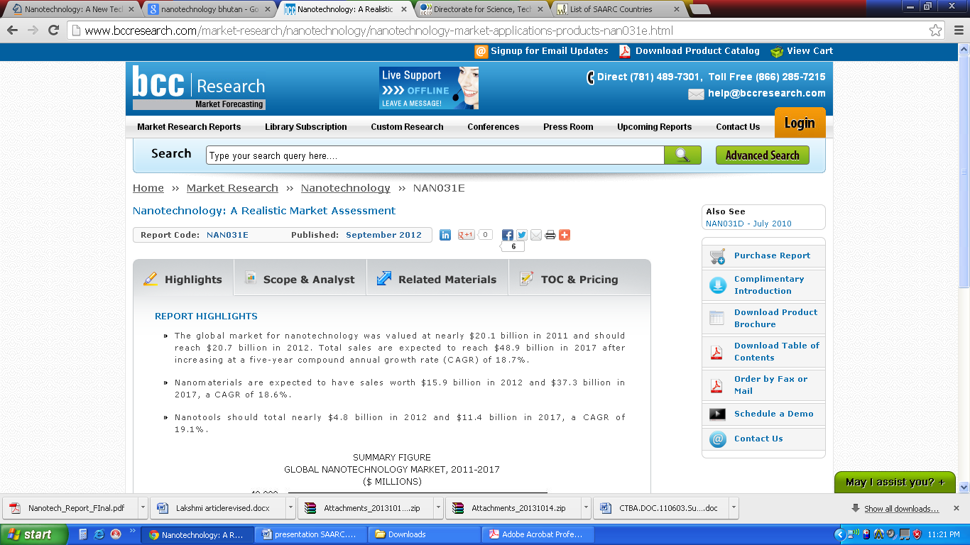
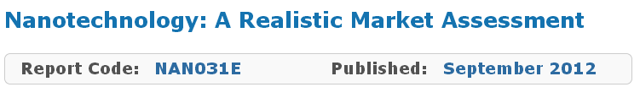
Nanotechnology is currently one of the fastest growing industries in history as evidenced by the estimate that by the year 2015, the annual global market for nano-related products and services will exceed $1 trillion.
REPORT HIGHLIGHTS
The global market for nanotechnology was valued at nearly $20.1 billion in 2011 and should reach $20.7 billion in 2012. Total sales are expected to reach $48.9 billion in 2017 after increasing at a five-year compound annual growth rate (CAGR) of 18.7%.
Nano materials are expected to have sales worth $15.9 billion in 2012 and $37.3 billion in 2017, a CAGR of 18.6%.
Nano tools should total nearly $4.8 billion in 2012 and $11.4 billion in 2017, a CAGR of 19.1%.
SUMMARY FIGURE
GLOBAL NANOTECHNOLOGY MARKET, 2011-2017 ($ MILLIONS)
Source:

Slide 13

INTERDISCIPLINARY:
Who is interested? a few who are….
Physicists
Biologists
Chemists
NANOSTRUCTURING
Environmentalists
Engineers
Metallurgists

Slide 14
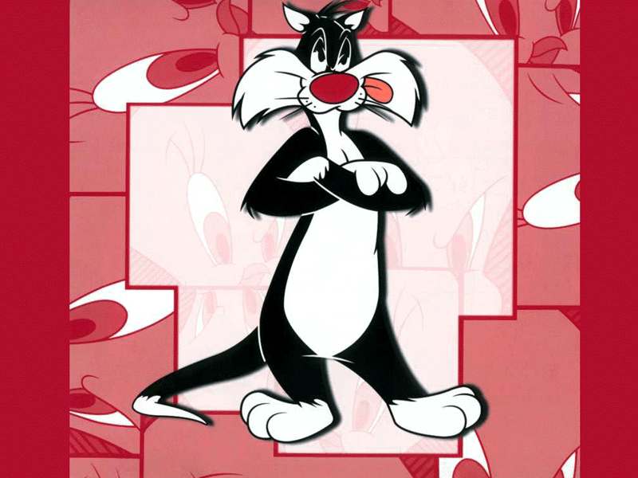
Special Properties are mostly due to:
Extremely large
surface to volume
ratio
How about that?
It’s all superficial!!
A large no. of atoms are on surface/grain boundaries. For example, in a 2nm gold grain, about 50% atoms are on surface.

Slide 15
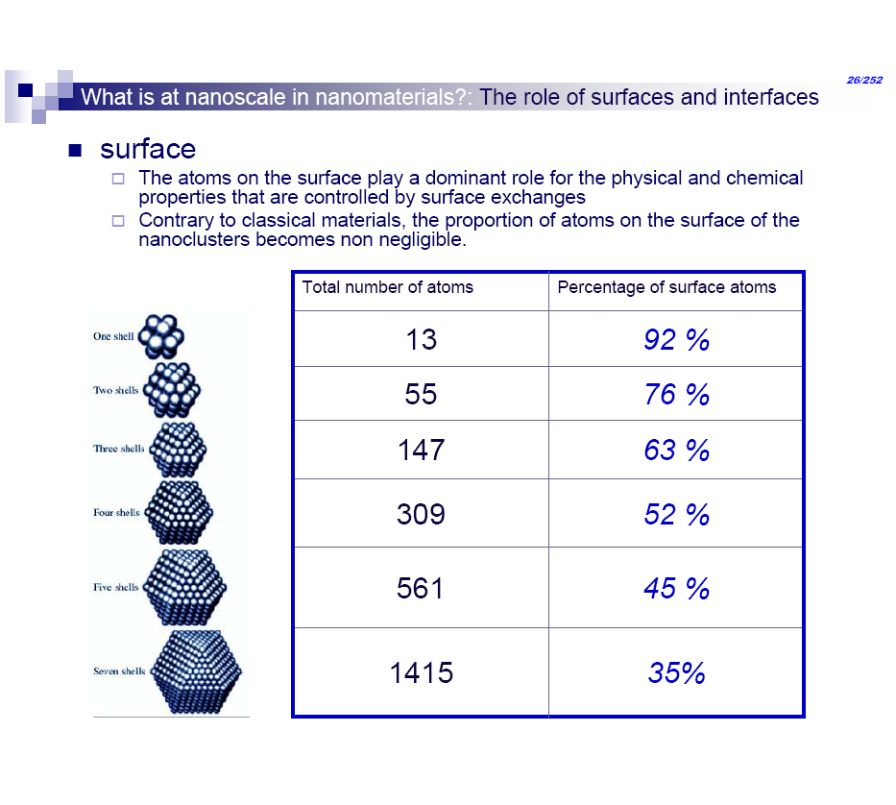
Surface effects
The atoms on the surface play a dominant role for physical & chemical properties
These are controlled by surface exchanges
Total Number of atoms | % of atoms on surface
13 | 92
55 | 76
147 | 63
309 | 52
561 | 45
1415 | 35
As compared to bulk materials, the proportion of atoms on the surface becomes non-negligible

Slide 16
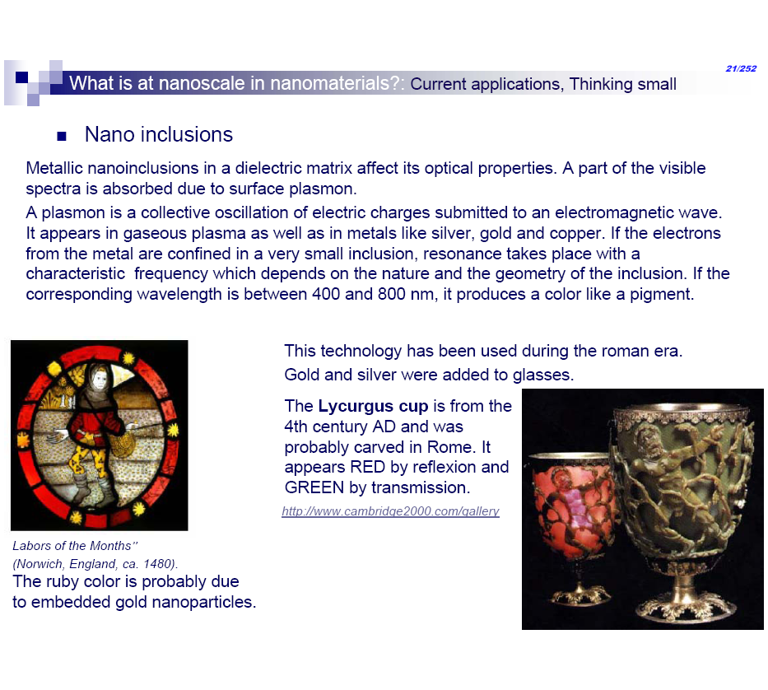
Examples of some special properties at the nano sizes
Sizes ≈ Atomic or molecular length scales
Modifies properties of matter
Quantum effects strong
Magnetic moment/ Conductivity
Reactivity
Color
Changes color
Bulk Gold
1480 stained glass, England. The ruby color is attributed to embedded gold nano particles
2nm
Low temp; catalyst
Inert
Nano sized

Slide 17
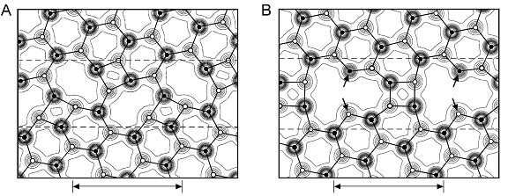
Examples of some special properties at the nano sizes
On becoming nanosized, large no. of atoms are on surface
Surface is strained
Bonds are broken (‘dangling’ bonds)
This makes the surface highly reactive
Increased porosity in nano particles allows better adsorption
A. Bulk material : no broken bonds
B. Strained surface (nano sized particles)
Dangling bonds

Slide 18
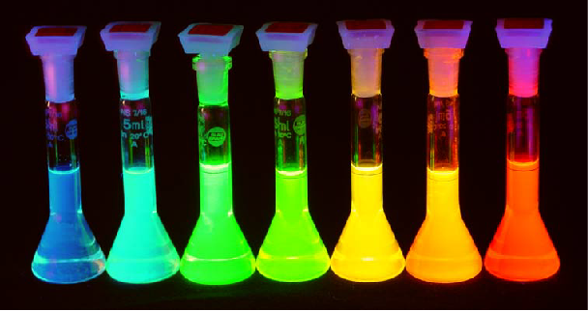
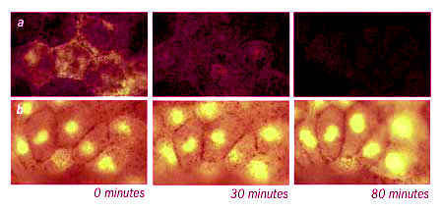
General types of nanostructures:
Quantum dots
Inorganic nanostructures measuring only a few nanometers with unique optical (luminescent) properties
Colloidal suspensions of nano sized CdSe (different sizes)
Imaging of mice brain cells using:
their fluorescence emission is stable
(color) tuned by varying the particle size or composition.
used as tracers
Conventional
dye
Quantum
dots

Slide 19

Quantum dots
Conduction Band
Intermediate levels
due to surface states
providing electron &
hole traps
Energy
Valence Band
The energy E_{R} released in the recombination of an electron and hole (the quantum unit of light) is
The color of the emitted light is controlled by
Here, E_{G} is the semiconductor band gap and E_{e} and E_{h} the electron and hole confinement energies.
E2
E2-E1
E_{e} and E_{h} become larger with decreasing L and therefore can be controlled with an appropriate choice of L.
E1

Slide 20
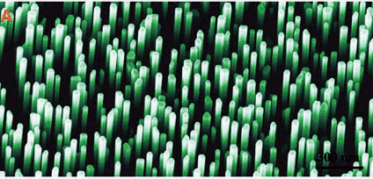
General types of nanostructures:
These are strands with lengths of the order of microns and diameters in the nanometric range. Carbon nanotubes are well known examples
Have superior strength
Can be used to load other substances
Used as contacts, in cooling devices etc.
Nano wires
Zinc oxide nano wires

Slide 21
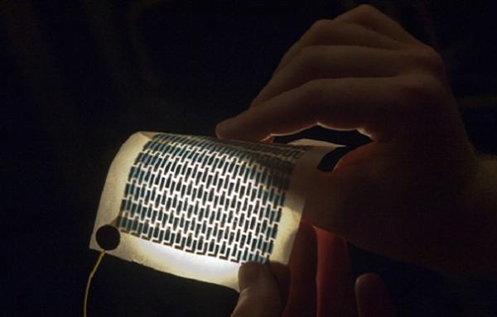
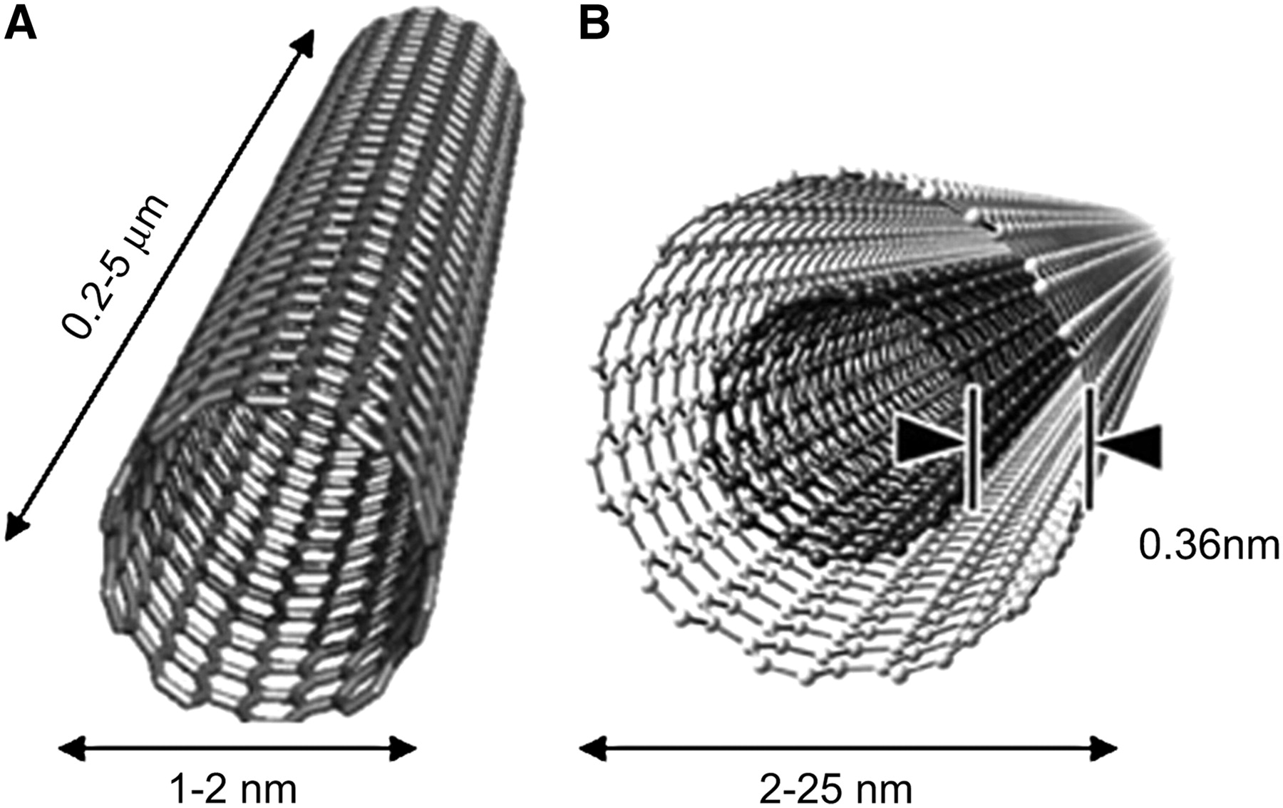
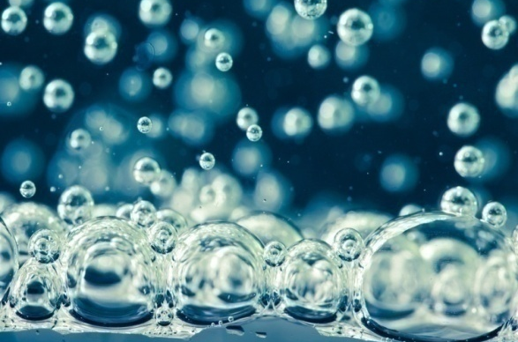
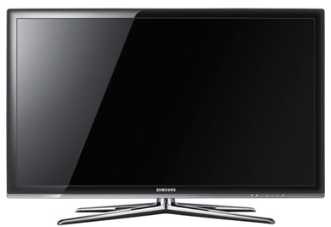
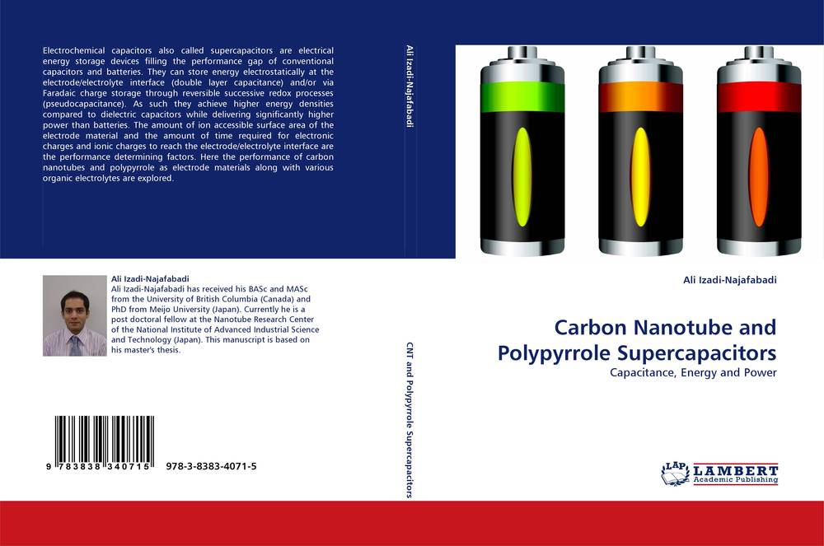
General types of nanostructures:
Carbon Nanotubes
Improve efficiency in films
Liquid purifiers
Credit: MIT/ Patrick Gillooly
Credit: nikkytok/Shutterstock
Supercapacitors
Improved displays
Credit: Samsung

Slide 22
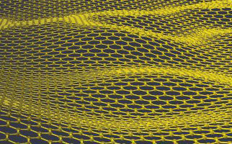
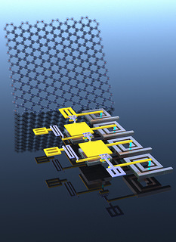
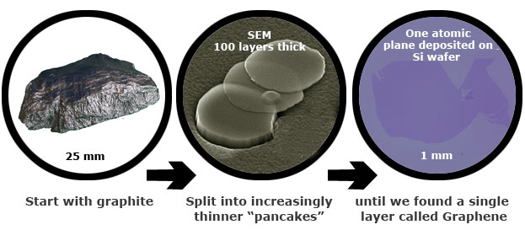
General types of nanostructures:
Graphene
Although just one atom thick, graphene posses outstanding mechanical, electronic, optical, thermal and chemical properties. Graphene is a one atom thick sheet made of carbon atoms, arranged in a honeycomb (hexagonal) lattice.
IBM graphene RF receiver
Source: http://www.graphene.manchester.ac.uk/story/
The researchers have taken a new approach which IBM said is closer to mainstream silicon CMOS manufacturing processes. This was used to produce a multi-stage graphene RF receiver with what IBM called “big performance” gains.
The multi-stage graphene RF receiver integrated circuit consists of 3 graphene transistors, 4 inductors, 2 capacitors, and 2 resistors.
Source : Electronics weekly.com , 31 Jan, 2014 at http://www.electronicsweekly.com/news/research/device-rd/,

Slide 23


General types of nanostructures: Thin films/ multilayers
A few nm thick multilayers with different energy gaps.
Used for lasers, microelectronics
Fe layer
(dark)
Al layer
(light)
If the two layers have a periodicity L = L1+ L2, new forbidden bands are formed ⇒ origin of the “gap engineering” in microelectronics
Fe-Al multilayer system. An example of ferromagnetic- non magnetic spacer layer MLS. Individual layer thickness decides the strength and type of coupling (i.e, ferro/antiferromagnetic etc.)
Used in memory devices

Slide 24
Common Preparation/Methodology
Melting constituents using induction furnaces, argon arc melting etc.
Chemical Methods
Bottom-up
Proper temperature treatment
(annealing/quenching etc.)
Rolling, ball milling etc.
Top down
Mechanical alloying
Constituent powders
Nano Alloy
Powders

Slide 25
How is Nanotechnology being used today? From the very serious to fairly frivolous…but all seriously multi-billion dollar industries
Products being used today:
Computer hard drives contain nano-thin layers of magnetic materials allowing a significant increase in storage capacity.
Magnetic memory, automotive sensors, landmine detectors
Burn and wound dressings
Water filtration
Dental-bonding agent
Coatings for easier cleaning glass
Bumpers and catalytic converters on cars
Protective and glare-reducing coatings for eyeglasses and cars
Sunscreens and cosmetics
Longer-lasting tennis balls (and light-weight, stronger tennis racquets)
Stain-free clothing and mattresses.
Improving Areas In the following:
  Manufacturing
  Electronics
  Health Care
  Pharmaceuticals
  Chemical Plants
  Transportation
  Energy
  Sustainability

Slide 26


Some nano products in the market :
Self cleaning windows
The Pilkington Activ brand by Pilkington is claimed by the company to be the first self-cleaning glass. Pilkington Activ™ consists of a 20–30 nm layer of nanocrystalline titanium dioxide deposited by an atmospheric pressure chemical vapor deposition technique onto soda-lime silicate float glass. The coating is also robust and cannot be damaged by application of adhesive tape or moderate mechanical abrasion; Pilkington claim that the coating will last the lifetime of the window frame.

Slide 27

Some nano products in the market :
Self cleaning windows
The glass cleans itself in two stages.
The coating on the glass makes it super hydrophilic
In sunlight, the photocatalytic
stage of the process breaks down the organic dirt on the glass using ultraviolet light
During the following stage, rain or other water washes away the dirt, leaving almost no streaks, because water spreads evenly on superhydrophilic surfaces

Slide 28

Some nano products : Self cleaning fabric
The self-cleaning fabrics also work using the photocatalytic properties of titanium dioxide
The fabric is coated with a thin layer of titanium dioxide particles that measure only 20 nanometers in diameter.
When this semi-conductive layer is exposed to light, photons excite electrons up to the conduction band.
The excited electrons within the crystal structure react with oxygen atoms in the air, creating free-radical oxygen.

Slide 29

Some nano products :
Self cleaning fabric
These oxygen atoms are powerful oxidizing agents, which can break down most carbon-based compounds through oxidation-reduction reactions.
In these reactions, the organic compounds (i.e. dirt, pollutants, and micro organisms) are broken down into substances such as carbon dioxide and water.
Since the titanium dioxide only acts as a catalyst to the reactions, it is never used up. This allows the coating to continue breaking down stains over and over.

Slide 30

Some nano products : Fabric which does not get dirty!
This facilitates like a cushion of air on the fabric surface without lowering the strength of fabric.
When water hits on the surface of the fabric, it beads on the points of the whiskers.
The beads compress the air in the cavities between the whiskers creating extra resistance.
The water repellant property of fabrics is obtained by creating combination of micro and nano-whiskers with low surface energy.
These are generated by wax crystals in the range of size 10-3 for a typical cotton fibre, which are added to the fabric to create a peach fuzz effect.

Slide 31


Some nano products : Fabric which does not get dirty!
In technical terms, the fabric has been rendered super-non wettable or super-hydrophobic
G3i's GreenShield™ multifunctional textile finishes
The whiskers also create fewer points of contact for dirt. When water is applied to soiled fabric, the dirt adheres to the water far better than it adheres to the textile surface and is carried off with the water as it beads up and rolls off the surface of the fabric.

Slide 32




Facilities for Sample Preparation
at Department of Physics, MLSU, Udaipur
Spex 8000 M High energy ball mill
(nano samples by milling/alloying)
Argon arc furnace
(for bulk alloys)
Electron Beam Gun / Thermal evaporation unit
(for films/multilayers)
Magnetic stirrer with heater, muffle furnace etc.
(chemical preparation route + annealing)

Slide 33

Sample Preparation Lab

Slide 34


Characterization
X-ray diffraction- structure and size

